Slide 1
TDVR: Tower Defense in Virtual Reality
By Andrew Munoz and Zach Young
CS 791 - Virtual Reality

Slide 2
Introduction
Virtual Reality Multiplayer Competitive Experience
Tower Defense Based
Strategy and Dexterity
Options to pick different combat units
Simulation built using the Unity game engine

Slide 3
Design
Hardware
HTC Vive
Software
Unity game engine with C#
SteamVR
Mirror

Slide 4
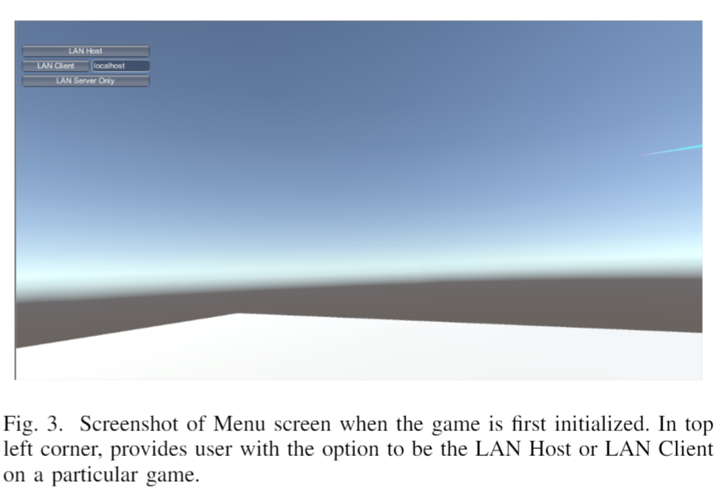
Main Menu
Can either be host or client
Client connects to host through steam id

Slide 5
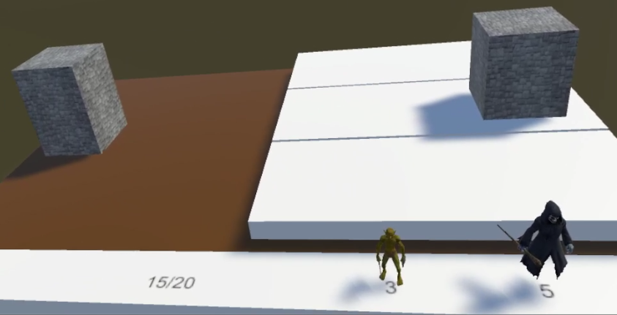
Gameplay: Mini Board
Unit Costs
Total resources
Three Locations

Slide 6
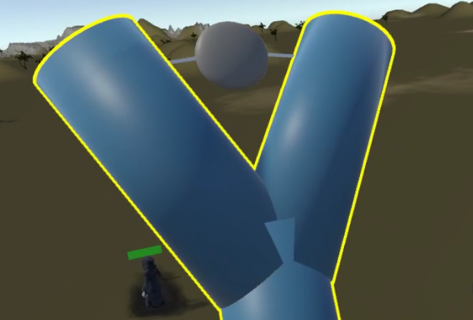
Gameplay: Slingshot
Hold with one hand shoot with the other
Projectile speed based on distance pulled back
Projectile direction based on direction from object holder release position and object holder initial position

Slide 7
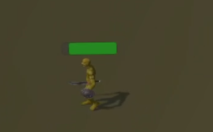
Gameplay: Units
Health bar
Always faces the local player
Green for friendly, red for enemy
Move towards and attack nearest enemy when in range
Different stats for different units

Slide 8
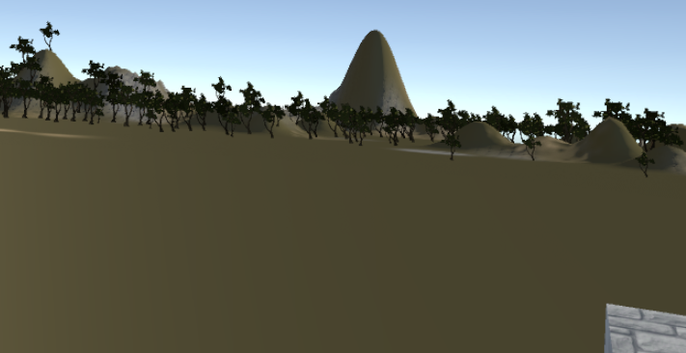
Gameplay: Environment
Provide more immersive experience
Trees, hills, grass

Slide 9

Demo Video

Slide 10
Conclusion
Competitive Game that promotes dexterity and strategy
Networking is hard
Future work
Voice Chat
Audio
More units and weapons
Rematch functionality
Single Player
God view for spectators
Balancing

Slide 11
Live Demo

